Slide 1
Investing in the
District of Columbia’s
Public School Facilities
From Decades of Neglect to
Stewardship for our Future
Analyzed by 21st Century School Fund
April 19, 2016

Slide 2
What we hope you do with this information:
Take pride in our city’s civic investment!
Engage in a well-informed city-wide discussion to:
  Shape the FY2017-2022 capital budget and FY2017 facilities operating budget
  Ensure DC finishes modernizing DCPS facilities so there is equity for students and communities
  Explore ways to get better value from project expenditures
  Create plans and systems to ensure DC does not neglect its public school facilities again
  Examine adequacy, condition and equity among charter facilities
  Explore planning and appropriations efficiencies so we can afford to sustain DCPS and charter facilities alike

Slide 3
About the data
All student and building data is from SY 2014-2015
Expenditure and budget authority data provided by DC CFO
School and building descriptors from DCPS and public charter school board
Enrollments and student descriptors from OSSE
Project information from DGS and OCFO
Notes:
Project-by-project spending data was provided cumulative 1998-2015, then year-by-year for the planned 2016-2021 budget.
Frequently, portions of individual projects, or occasionally entire modernization projects, were accounted for in multi-school expenditure categories. Adjustments were made as possible using reported project costs. However, some projects remain to be adjusted and therefore, some project expenditures may seem unusually low.

Slide 4
D.C. Public School Facilities in 1995
August 14, 1995 - DCPS Superintendent’s Task Force on Education Infrastructure for the 21st Century:
“DCPS has not built a new school since 1980 and has not undertaken a full school modernization since 1985.
In fact, there are no model facilities in the District that fully support and enhance education, and to which other schools can aspire.”
Average age of DCPS Schools - 69.5 Years
DCPS had millions of GSF in excess space
DCPS schools were unhealthy and unsafe facilities with $1.2 billion (2015$) in deferred maintenance

Slide 5
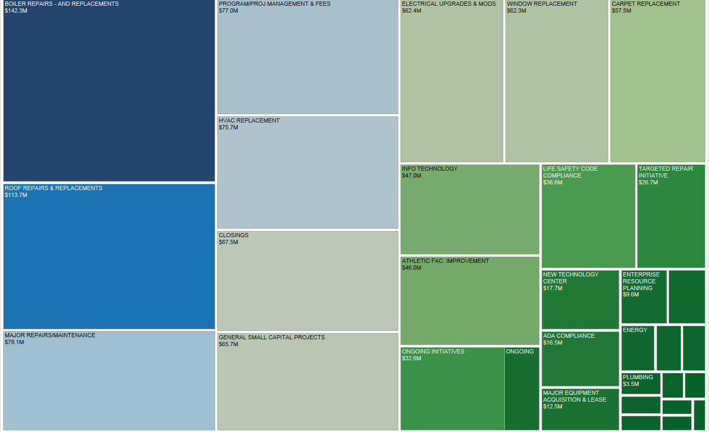
Digging Out
$1 billion in DCPS Multi-School Stabilization Projects FY1998-2015

Slide 6
Decades of disinvestment in DCPS facilities helped drive families to charter schools
DC’s annual charter school per-student Facilities Allowance add-ons aimed to ensure charter school students could be in adequate facilities
The 2016 annual per-student Facilities Allowance is $3,124 for regular students and $8,395 for residential school students.

Slide 7
Progress: $2.27 billion for DCPS Modernizations 2000-2015
Using 21st century facilities standards for health, sustainability, education and community use, DCPS embarks upon an unprecedented modernization program.
55 DCPS fully modernized or new facilities (by 2016)
  6,609,837 GSF, 58%
32 DCPS partly modernized facilities
  2,543,688 GSF; 22%
21 DCPS facilities not modernized
  2,208,692 GSF; 20%
Notes:
Project-by-project spending data was provided cumulative 1998-2015, then year-by-year for the planned 2016-2021 budget
Frequently, portions of individual projects, or occasionally entire modernization projects, were accounted for in multi-school expenditure categories. Adjustments were made as possible using reported project costs. However, some projects remain to be adjusted and therefore, some project expenditures may seem unusually low.

Slide 8
Accelerating Choice:
The Charter Facilities Allowance Add-on
  From 1998 to 2015, charter operators received $963,000,000 from the city in individual school facilities allowance add-ons.
  Funding for facilities cleaning, utilities, maintenance and minor repairs are included in the annual per student funding formula.
  The Facilities Allowance add-on was advanced so charters could pay for leasing buildings and capital construction, however, charter operators may use it for any purpose.
  Charter operators can also borrow to fund their facilities improvements.
    From 1998 to April 2015, $500 million in DC revenue bonds have been borrowed for school construction by 26 different charter operators.

Slide 9
Planning the future: Equity and Efficiencies 2016-2021
  Insist on efficiencies in District capital and operating spending on facilities
  2016-21 CIP, last year’s 6-year Capital Improvement Budget:
    1 DCPS school planned for replacement: Orr
    16 DCPS schools planned for full modernizations
    16 DCPS schools planned for partial modernization
    At current charter enrollment and Facilities Allowance add-on of $3,124 per student and $3,395 for residential students, charter Facility Allowance Add-Ons from 2016-21 will total $716,000,000 at minimum, (assuming charter enrollment at 2014-15 levels with no increase).

Slide 10
Equity Issues by Feeder Pattern
Past & Planned 2000-2021
Row Labels | # schools in feeder | DCPS Capacity | Gross Square Footage | % at Risk | Lifetime Budget | LTB by student | LTB by GSF
Anacostia HS | 12 | 6012 | 1,243,408 | 78% | $345,410,191 | $57,453 | $278
Ballou HS | 11 | 6456 | 1,333,677 | 81% | $303,357,254 | $46,988 | $227
Cardozo HS (9-12) | 12 | 6407 | 1,492,322 | 46% | $447,060,588 | $69,777 | $300
City-Wide | 11 | 4962 | 1,271,472 | 24% | $533,715,756 | $107,561 | $420
Coolidge HS | 5 | 3059 | 602,384 | 56% | $191,268,955 | $62,527 | $318
Dunbar HS | 10 | 5531 | 1,005,344 | 63% | $342,171,954 | $61,864 | $340
Eastern HS | 18 | 8870 | 1,745,287 | 43% | $420,799,937 | $47,441 | $241
Roosevelt HS | 5 | 2951 | 617,178 | 56% | $228,041,653 | $77,276 | $369
Wilson HS | 16 | 9025 | 1,556,666 | 15% | $729,474,794 | $80,828 | $469
Woodson HS | 10 | 4858 | 923,686 | 76% | $202,366,602 | $41,656 | $219
Grand Total | 110 | 58,131 | 11,791,424 |  | $3,743,667,684 | $64,401 | $317
Notes:
$ are NOT inflated to current

Slide 11
DCPS Capital Expenditures FY1998-2015 by Ward
Ward | # of School Facilities | Capacity for Students | % At Risk Students | Total Sq. Ft. | Capital Expenditures | FY 1998-2015 Expenditures Per Student | Exp. Per Sq.
1 | 13 | 6,666 | 43% | 1,734,874 | $293,811,240 | $44,076 | $169
2 | 10 | 3,849 | 33% | 865,256 | $184,898,708 | $48,038 | $214
3 | 10 | 6,407 | 14% | 1,079,474 | $348,368,506 | $54,373 | $323
4 | 18 | 7,470 | 49% | 1,810,406 | $269,503,503 | $36,078 | $149
5 | 15 | 7,657 | 50% | 1,788,040 | $453,631,525 | $59,244 | $254
6 | 20 | 8,496 | 42% | 1,986,103 | $250,008,269 | $29,426 | $126
7 | 17 | 7,900 | 74% | 1,596,141 | $263,567,634 | $33,362 | $165
8 | 24 | 10,106 | 78% | 3,048,537 | $450,138,816 | $44,541 | $148
School Total | 127 | 58,551 |  | 13,908,831 | $2,513,928,201
Multi-school |  |  |  | 12,000,000 | $1,236,424,292 |  | $103
DCPS Total |  |  |  |  | $3,750,352,493

Slide 12
Equity Issues by Ward not Addressed in Plans
Ward | # of School Facilities | Capacity for students by Ward | # At Risk Students by Ward | Totals Planned and Allotted FY2016-2021 | By school capacity | Per GSF
1 | 13 | 6,666 | 43% | $213,656,000 | $32,052 | $123
2 | 10 | 3,849 | 33% | $124,151,754 | $32,256 | $143
3 | 10 | 6,407 | 14% | $78,569,277 | $12,263 | $73
4 | 18 | 7,470 | 49% | $295,736,332 | $39,590 | $163
5 | 15 | 7,657 | 50% | $19,183,826 | $2,505 | $11
6 | 20 | 8,496 | 42% | $154,464,364 | $18,181 | $78
7 | 17 | 7,900 | 74% | $113,188,003 | $14,328 | $71
8 | 24 | 10,106 | 78% | $57,115,160 | $5,652 | $19
School Total | 127 | 58,551 |  | $1,056,064,716
Multi-school |  |  |  | $242,169,537
DCPS Total |  |  |  | $1,298,234,253

