Slide 1
At-Risk Funding and the Achievement Gap
Betsy Wolf
Parent at Amidon-Bowen Elementary School

Slide 2
Overview
Inequity in school funding in DCPS
Achievement gaps
Interventions to target achievement gaps

Slide 3
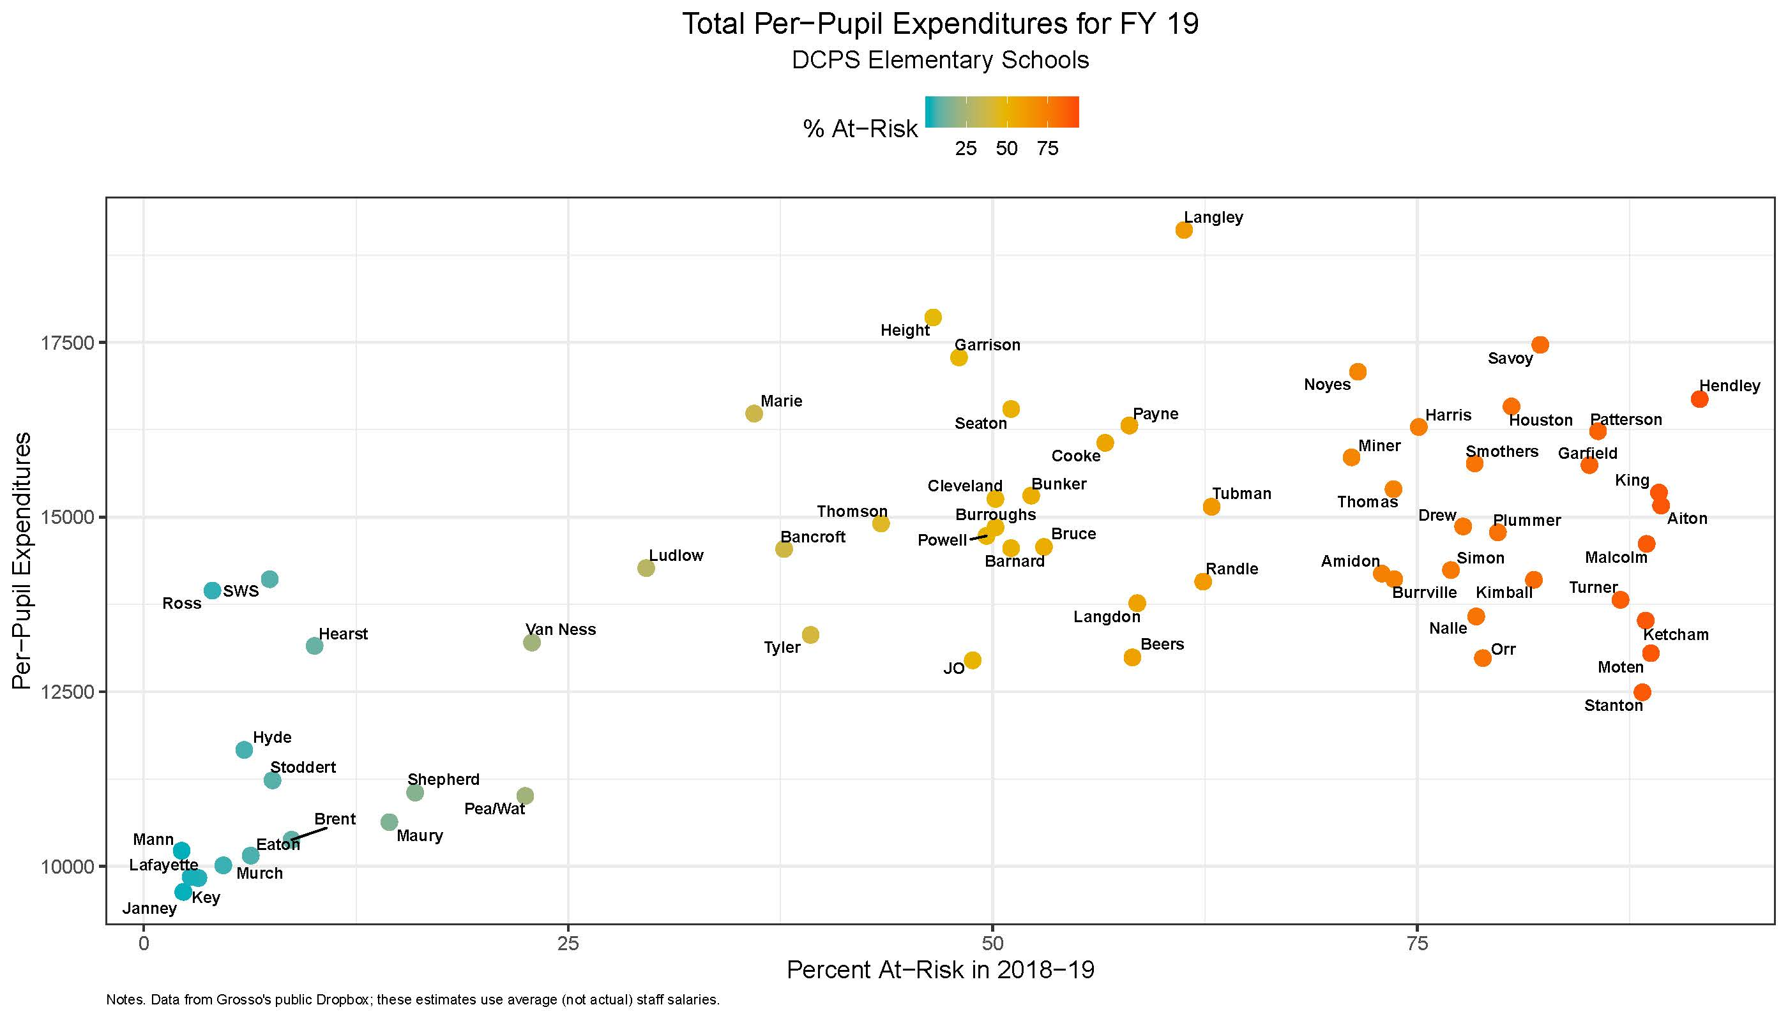
Looking at DCPS elementary schools, schools with greater proportions of “at-risk” students appear to receive greater resources (per pupil) than schools with lower proportions of “at-risk” students.

Slide 4
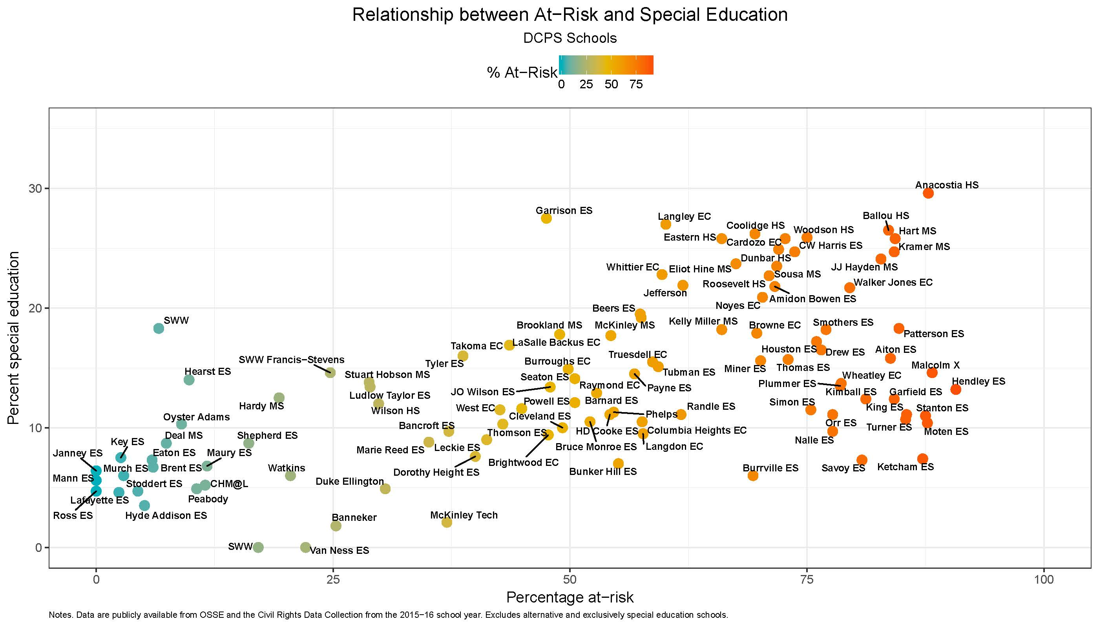
But keep in mind, DCPS schools with greater proportions of “at-risk” students also have higher rates of participation in special education services.

Slide 5
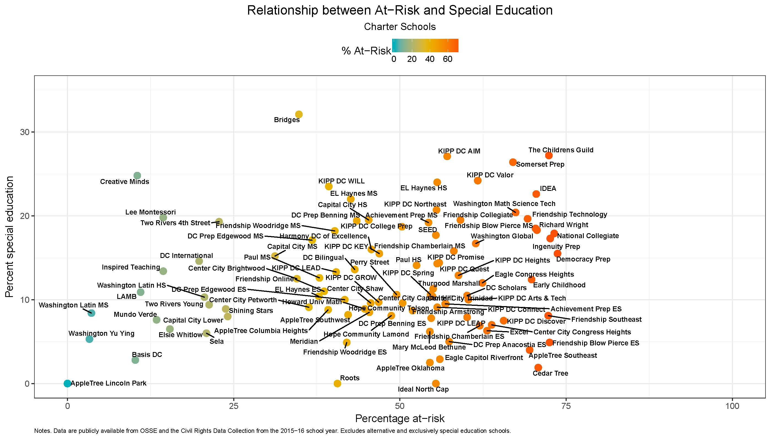
Side note: DCPS schools serve a greater share of special education students than charter schools, given their proportion of “at-risk” students. The sector-wide percentages of special education students showing equivalency across the two sectors are misleading in that regard.

Slide 6
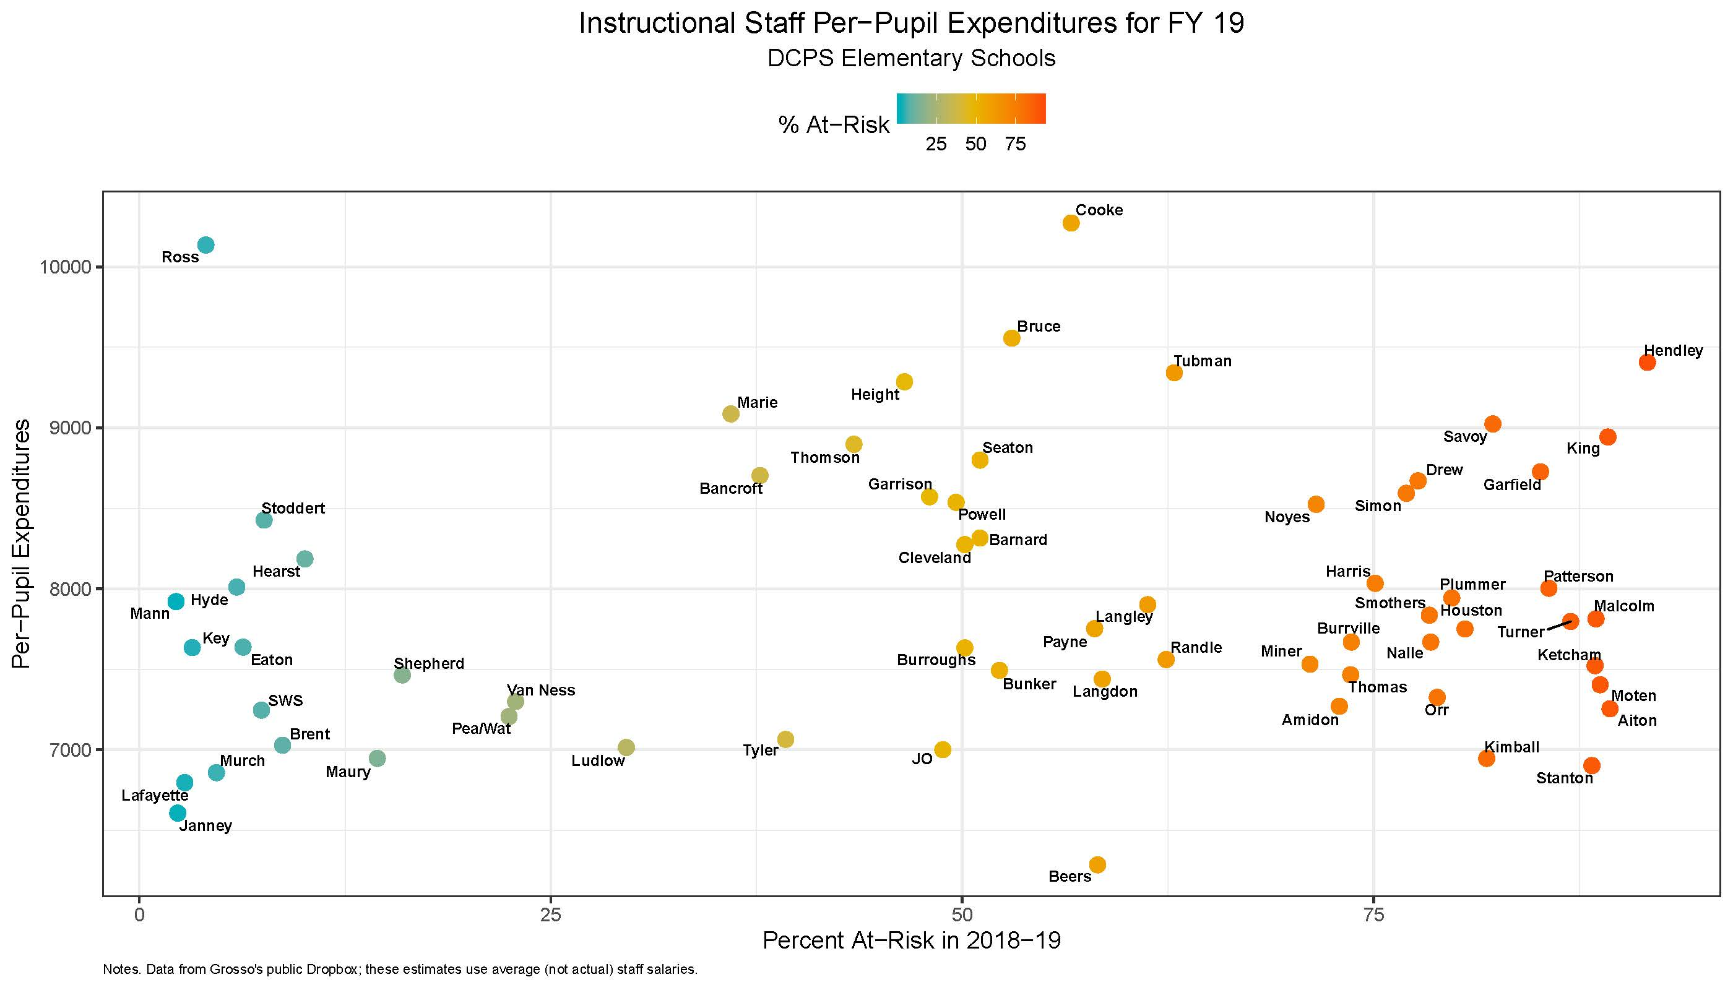
Removing funds to cover special education costs, we no longer see an investment in instructional resources for schools serving large proportions of “at-risk” students. But shouldn’t we?

Slide 7
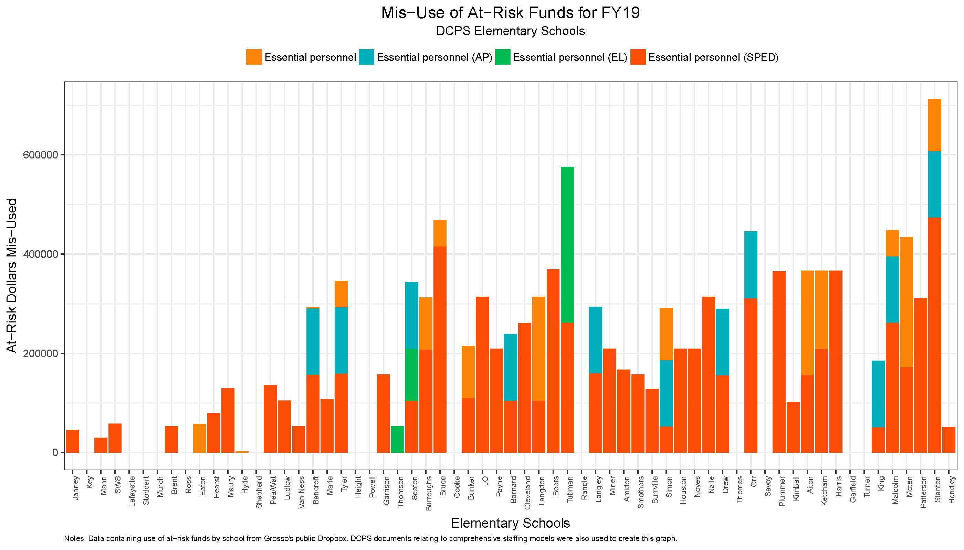
Where do “at-risk” funds go? Mary Levy has estimated that about 60% of “at-risk” funds are being used to supplant core and special education. Why is this the case?

Slide 8
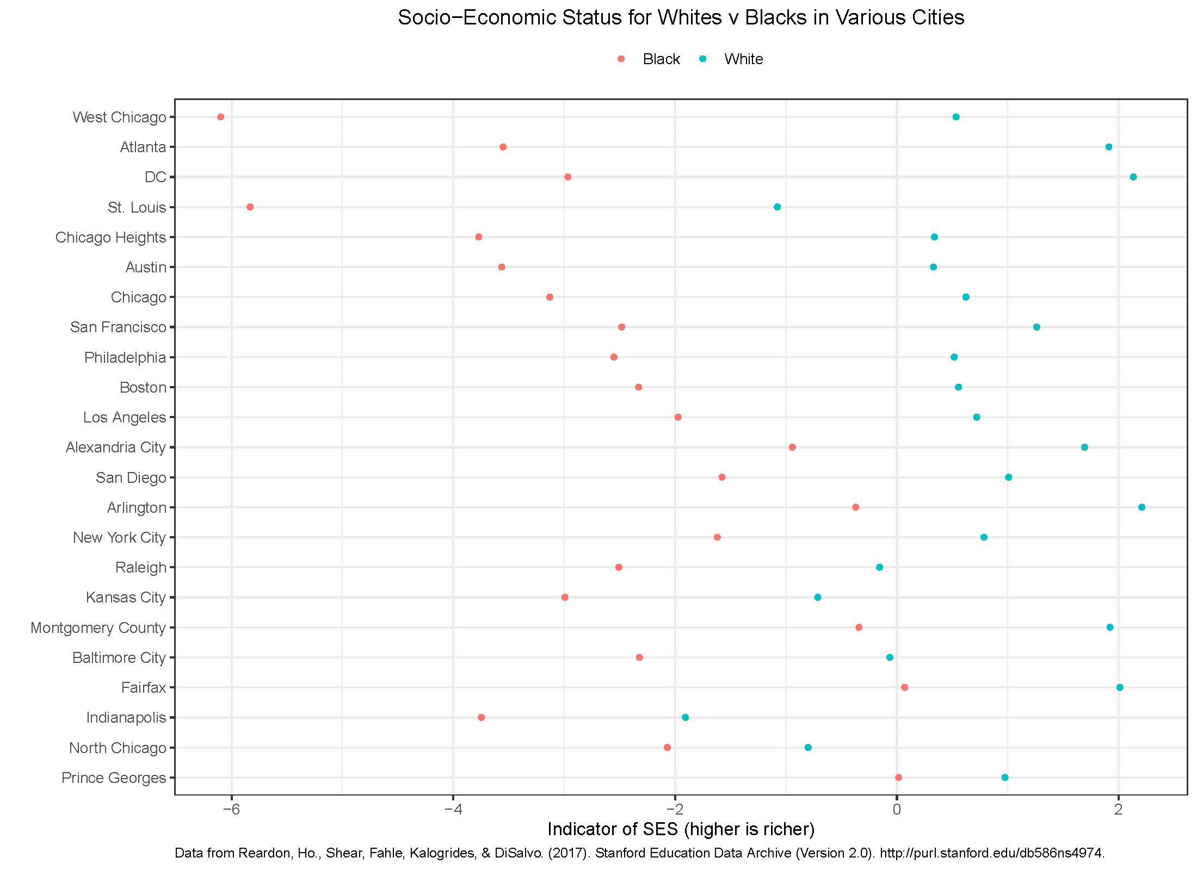
DC has an achievement gap problem that is directly related to economic inequality. Nationwide, the greater the economic inequality, the greater the achievement gap.

Slide 9
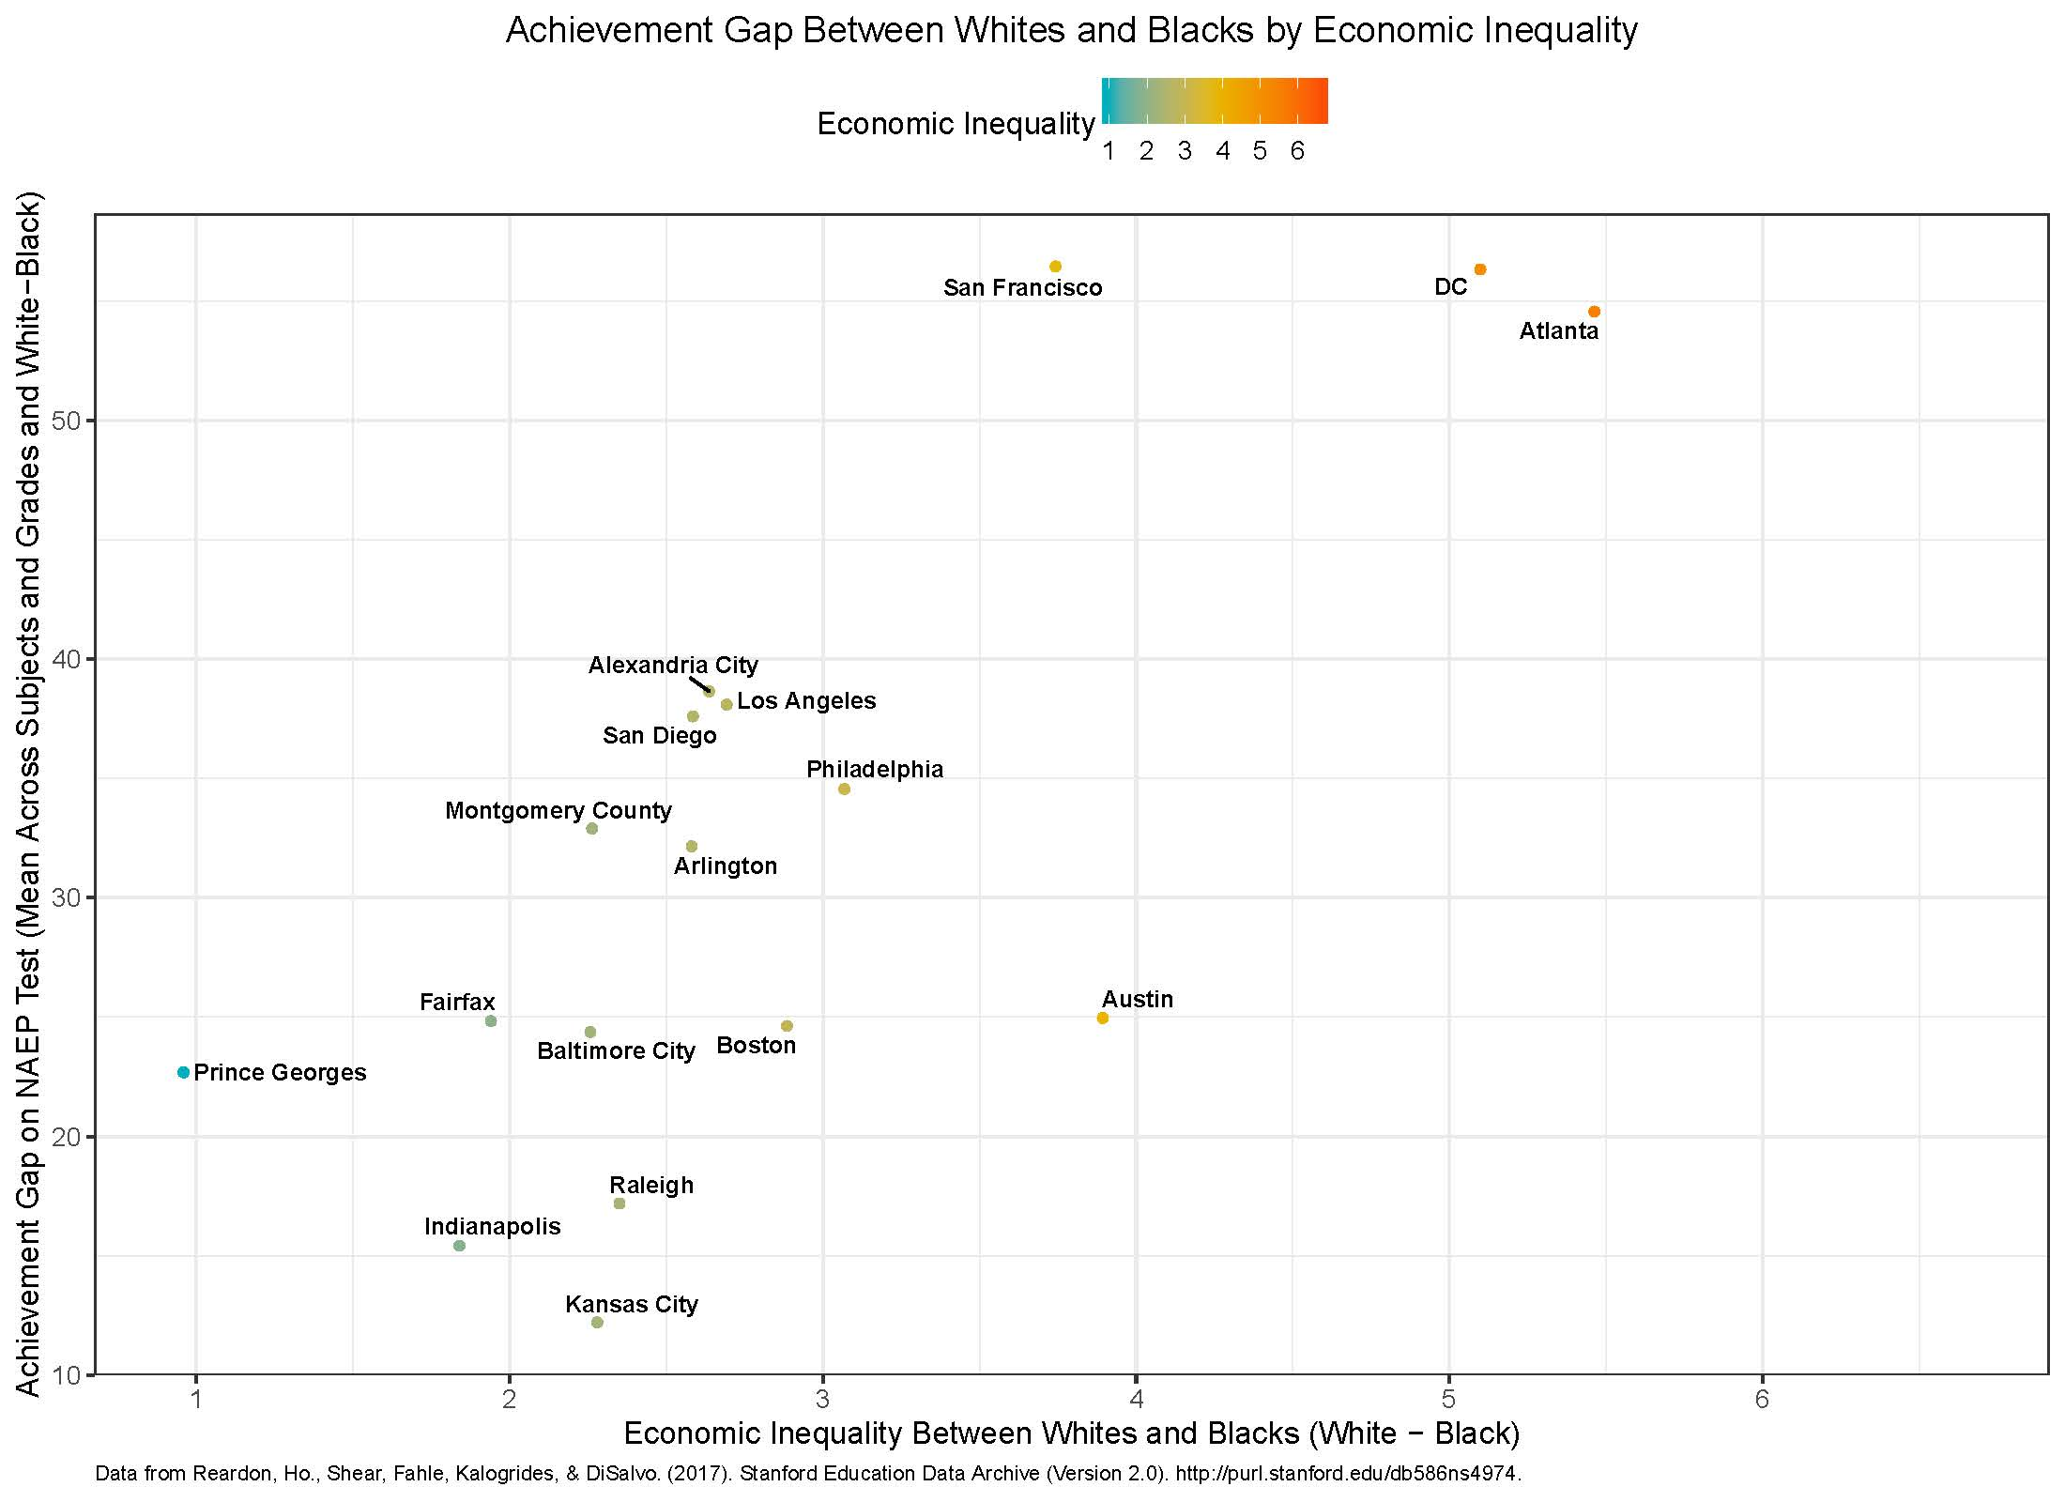
DC has an achievement gap problem that is directly related to economic inequality. Nationwide, the greater the economic inequality, the greater the achievement gap.

Slide 10
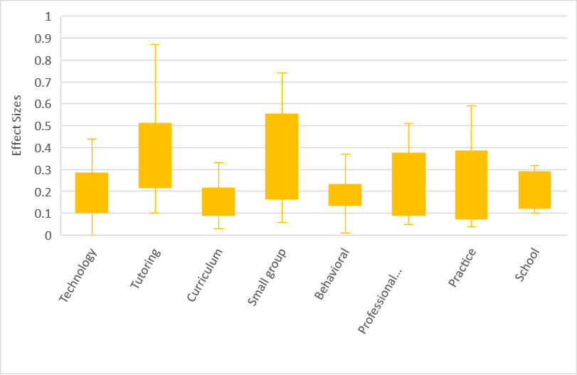
But if we want to target the achievement gap, we must provide supplemental resources to “at-risk” students, above and beyond core and special education. Which interventions appear to be the most promising? (Data from https://www.evidenceforessa.org/)

Slide 11
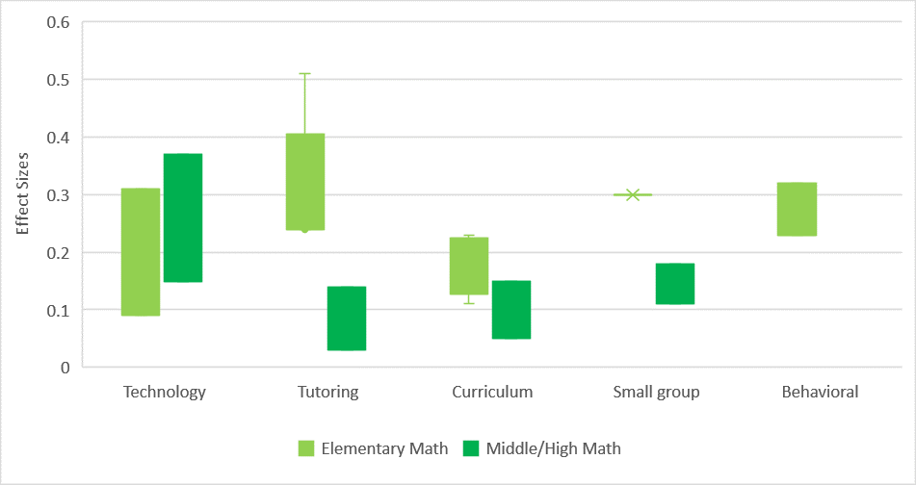
There are some variations across subjects and grade levels. In math, tutoring appears particularly impactful in elementary grades. Technology approaches look promising for middle and high school grades.

Slide 12
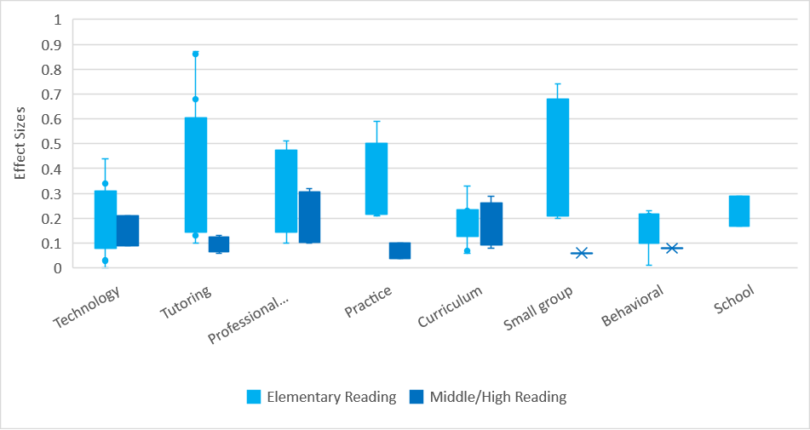
In reading, tutoring and small-group instruction appear impactful in elementary grades. Technology, professional development, and curricular approaches look promising for middle and high school grades.

Slide 13
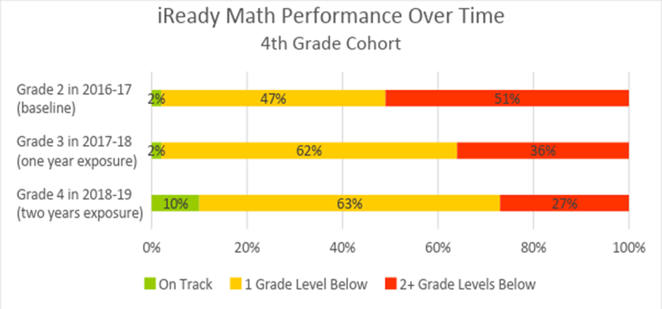
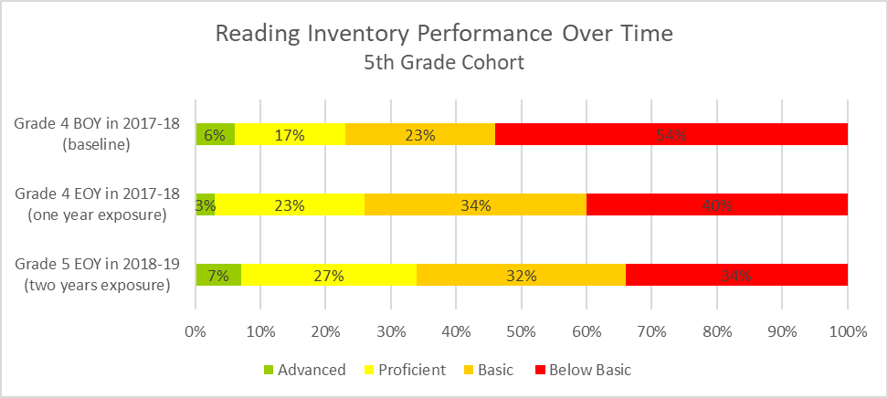
Amidon-Bowen Elementary School has benefitted from targeting resources towards small-group tutoring for struggling students in reading and math. But these supplemental resources (e.g. reading specialist and math intervention coach) were granted as “gifts” in addition to our original budget allocation. These are the kinds of supports that matter. Why don’t schools like Amidon-Bowen have enough money in their school budgets to fund supplemental resources, such as these?

Slide 14
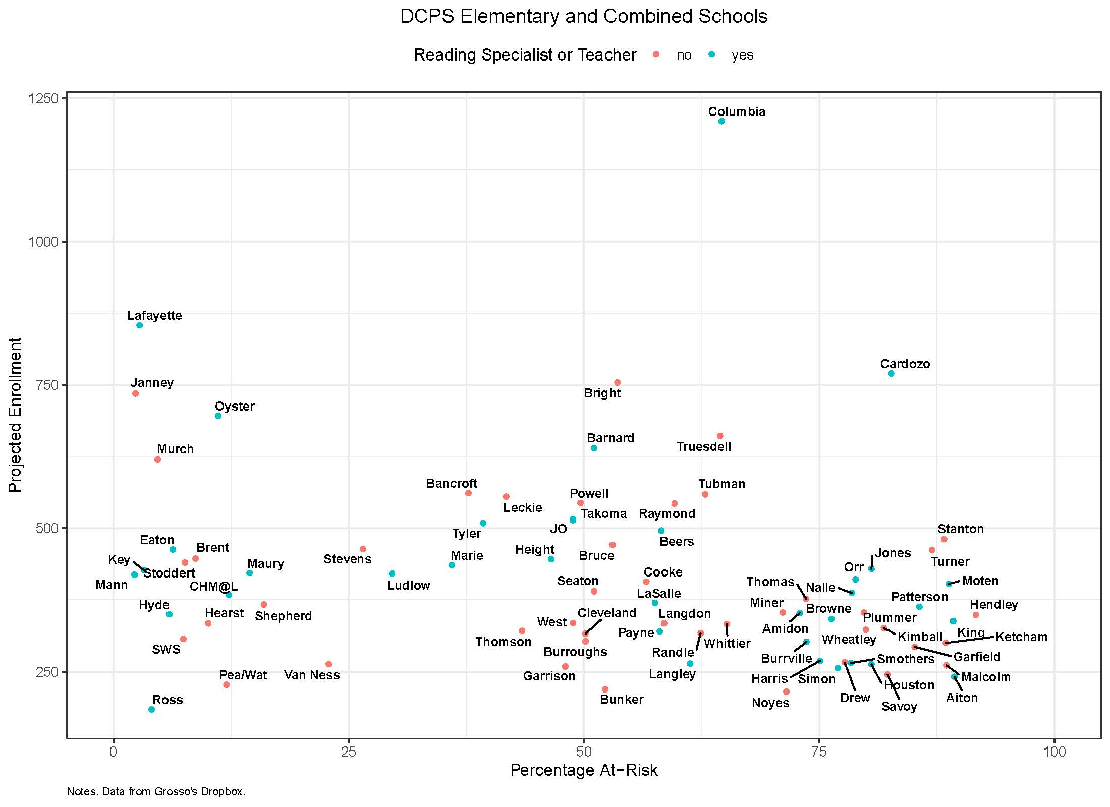
Which DCPS elementary and combined schools have reading specialists or teachers? Why is there no strategic investment in these resources for at-risk schools?

Slide 15
Summary
DCPS’s schools are not equitably funded
DC has large achievement gaps that are directly correlated with vast economic inequality
Interventions exist that would narrow the achievement gap but we are not targeting supplemental instructional supports to “at-risk” students

